Slide 1
Concrete Compressive Strength Analysis
By
Jason Park

Slide 2
The Problem
Concrete is one of the most important material in civil engineering.
Concrete is a mixture of cement, blast furnace slag, fly ash, water, superplasticizer, coarse aggregate, fine aggregate, and age
Concrete Compressive Strength is a non linear function.
What would be optimal predictive model?

Slide 3
DATA
Concrete Compressive Strength data form UCI archive.
1030 instances
9 attributes - cement, blast furnace slag, fly ash, water, superplasticizer, coarse aggregate, fine aggregate, age, concrete compressive strength
No missing values
It is downloaded and converted to csv file in R.

Slide 4
Analysis
Use 5 different models to find the best fitting model.
Linear Regression
Penalized Linear Regression
k-Nearest Neighbors
CART
Support Vector Machines with Linear Kernel

Slide 5
Result - RMSE
 | Min. | 1st Qu. | Median | Mean | 3rd Qu. | Max. | NA’s
LM | 9.623 | 10.360 | 10.50 | 10.56 | 10.78 | 11.33 | 0
GLM | 9.874 | 10.530 | 10.73 | 10.72 | 10.90 | 11.54 | 0
KNN | 8.817 | 9.678 | 10.01 | 10.06 | 10.52 | 11.04 | 0
RPART | 11.140 | 11.930 | 12.80 | 12.64 | 13.35 | 14.01 | 0
SVM | 10.540 | 10.880 | 11.25 | 11.50 | 11.60 | 14.71 | 0

Slide 6
Result-RSquared
 | Min. | 1st Qu. | Median | Mean | 3rd Qu. | Max | NA’s
LM | 0.5534 | 0.5711 | 0.5880 | 0.5915 | 0.6095 | 0.6323 | 0
GLM | 0.5050 | 0.5634 | 0.5824 | 0.5796 | 0.5976 | 0.6482 | 0
KNN | 0.5738 | 0.6207 | 0.6326 | 0.6357 | 0.6554 | 0.7339 | 0
RPART | 0.2680 | 0.3631 | 0.4240 | 0.4200 | 0.4614 | 0.5692 | 0
SVM | 0.4484 | 0.5475 | 0.5676 | 0.5639 | 0.5914 | 0.6199 | 0

Slide 7
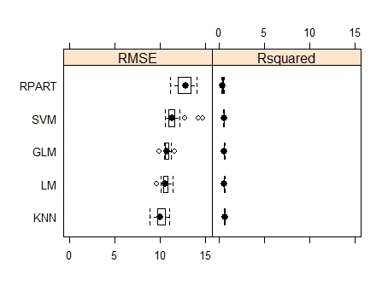
Result – Graph

Slide 8
Analysis with Cross Validation with k = 5 Results- RMSE
 | Min. | 1st Qu. | Median | Mean | 3rd Qu. | Max. | NA’s
LM | 10.040 | 10.060 | 10.620 | 10.600 | 10.810 | 11.46 | 0
GLM | 9.809 | 10.210 | 10.760 | 10.640 | 10.810 | 11.59 | 0
KNN | 8.328 | 8.619 | 9.049 | 9.186 | 9.681 | 10.25 | 0
RPART | 12.110 | 12.550 | 12.950 | 13.250 | 13.540 | 15.13 | 0
SVM | 10.480 | 10.490 | 10.810 | 11.090 | 11.620 | 12.06 | 0

Slide 9
Results – RSquared
 | Min. | 1st Qu. | Median | Mean | 3rd Qu. | Max. | NA’s
LM | 0.5653 | 0.5676 | 0.6123 | 0.6019 | 0.6230 | 0.6413 | 0
GLM | 0.4906 | 0.5979 | 0.6171 | 0.6004 | 0.6196 | 0.6756 | 0
KNN | 0.6673 | 0.6741 | 0.6750 | 0.6808 | 0.6828 | 0.7050 | 0
RPART | 0.3989 | 0.4096 | 0.4228 | 0.4569 | 0.4837 | 0.5697 | 0
SVM | 0.4897 | 0.5529 | 0.5999 | 0.5869 | 0.6295 | 0.6623 | 0

Slide 10
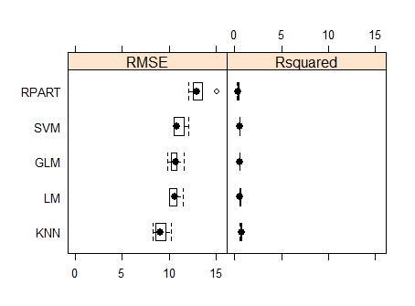
Results - Graph

Slide 11
Best Performance and Tuning
Best performance is KNN model in RMSE and Rsquared.
Caret in R used default value for k.
Tuning the model by finding optimal k

Slide 12
Tuning result
K | RMSE | Rsquared
2 | 10.53107 | 0.6103871
3 | 10.26003 | 0.6211551
4 | 10.06226 | 0.6318049
5 | 10.00809 | 0.6343718
6 | 10.01974 | 0.6335351
7 | 10.08588 | 0.6281979
8 | 10.10716 | 0.6266619
9 | 10.17382 | 0.6220246
10 | 10.25962 | 0.6158488

Slide 13
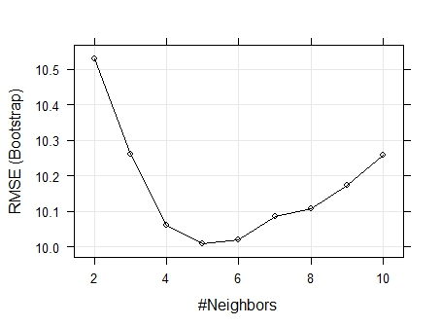
Tuning Result - Graph

Slide 14
Test with Final Model
K= 5 gives the best fitting model.
With best fitting model, predicting with testing set gives following values.
RMSE = 9.2424244
Rsquared = 0.7033052

Slide 15
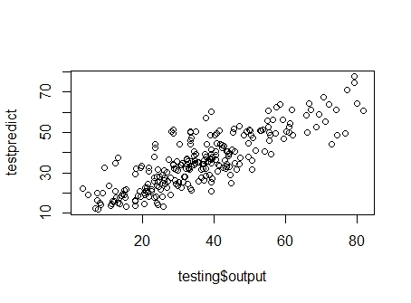
Predicted vs. Actual Testing Set

Slide 16
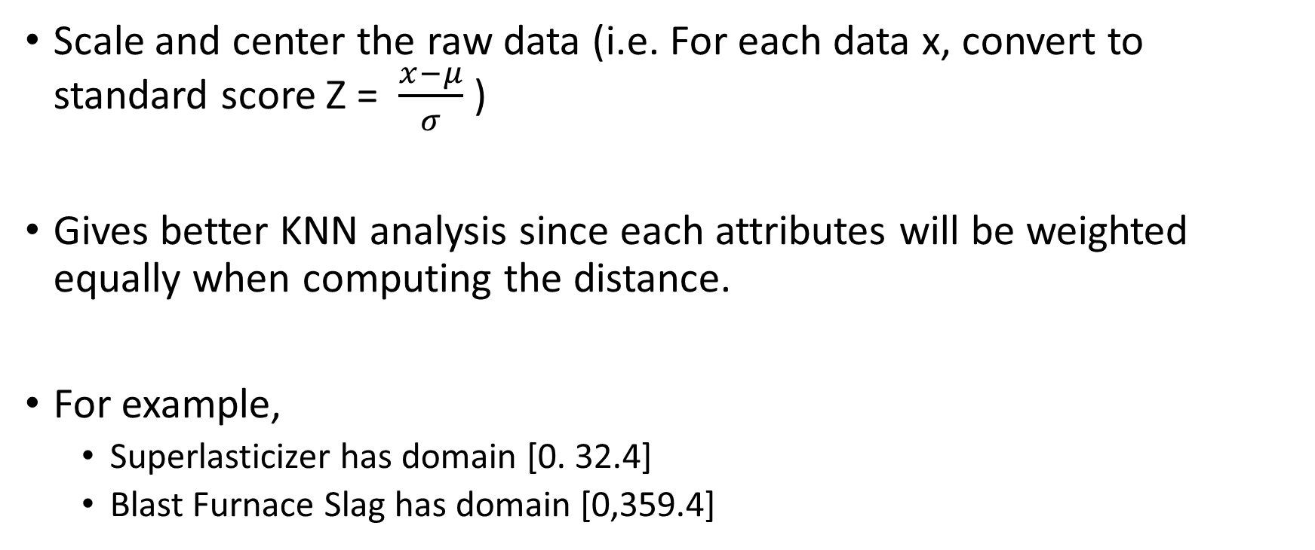
PreProcessing
Scale and center the raw data (i.e. For each data x, convert to standard score Z = $\frac{x−μ}{σ}$ )
Gives better KNN analysis since each attributes will be weighted equally when computing the distance.
For example,
Superlasticizer has domain [0. 32.4]
Blast Furnace Slag has domain [0,359.4]

Slide 17
Finding k with PreProcessed Data
K | RMSE | Rsquared
2 | 10.433967 | 0.6185847
3 | 10.170432 | 0.6288326
4 | 9.990404 | 0.6383930
5 | 9.890306 | 0.6433327
6 | 9.906930 | 0.6415088
7 | 9.929218 | 0.6390837
8 | 9.966993 | 0.6361390
9 | 10.030968 | 0.6314831
10 | 10.093267 | 0.6274357

Slide 18
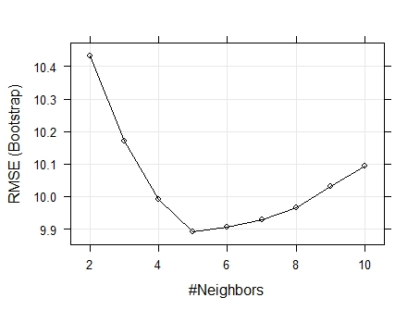
Finding k with PreProcessed Data - Graph

Slide 19
Final Result
K= 5 gives the best fitting model.
With best fitting model, predicting with testing set gives following values.
RMSE = 9.1991733
Rsquared = 0.7059835
This is the best approximation.

Slide 20
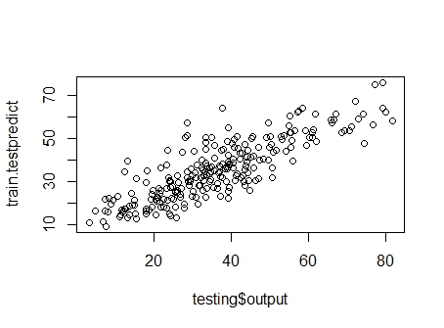
Final Result – Graph

Slide 21
Conclusion
PreProcessed KNN model with k = 5 is the best fitting model.
It is useful to predict the concrete compressive strength from given input data.
Possible future research
Optimal compressive strength with minimum cost
Optimal compressive strength in a very short period time.

Slide 22
Thank you.

